Slide 1

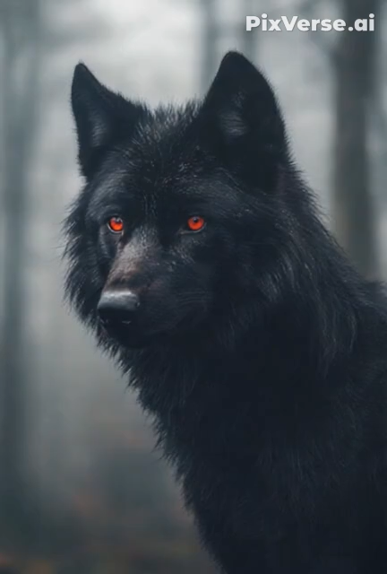
PREDATOR

Slide 2
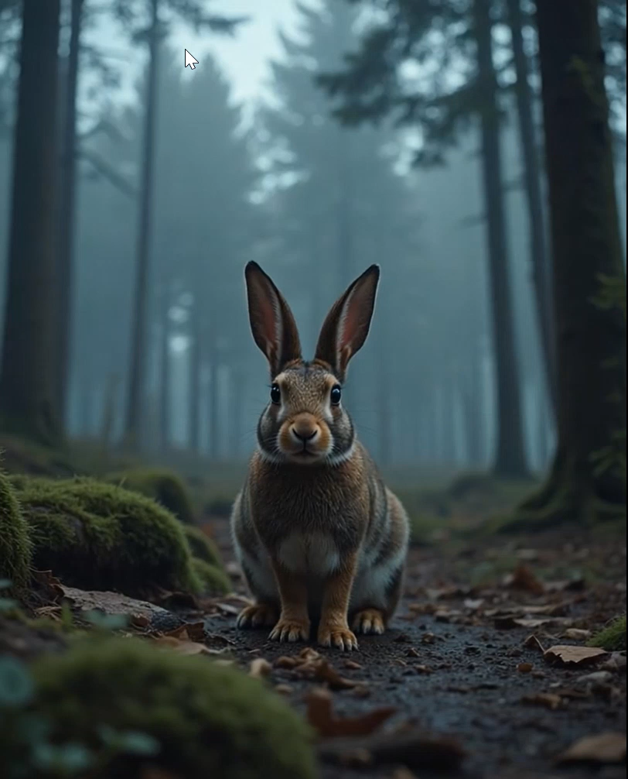
Prey

Slide 3



PREDATOR PREY DYNAMICS
LOTKA VOLTERRA MODEL
1
Slide 1
NEXT SLIDE

Slide 4
Group Members
Ayesha Akhlaq
Faizan Azam
Minaal Amjad
Abdul Moiz Iqbal
3
NEXT SLIDE
Slide 3

Slide 5





CONTENTS
2
NEXT SLIDE
Slide 2

Slide 6
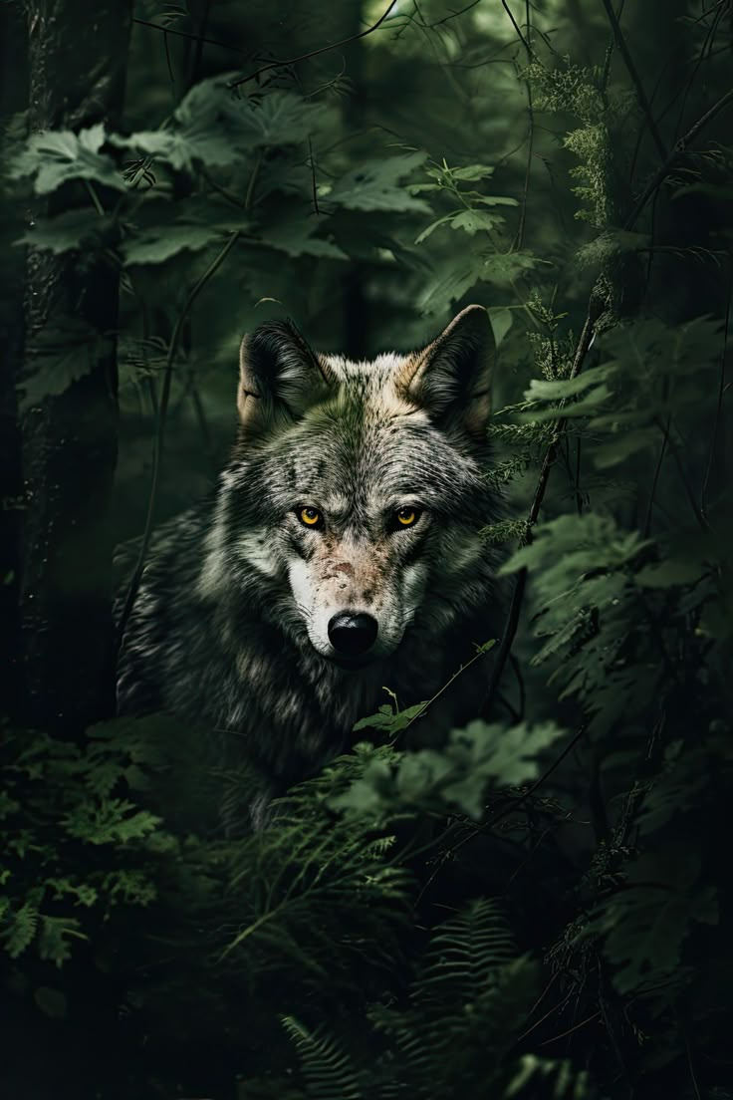
INTRODUCTION
A mathematical model used to describe how two species interact in an ecosystem:
Prey (e.g., rabbits) reproduce and increase in number over time.
Predators (e.g., foxes) survive by consuming prey.
prey is abundant, predator numbers grow.
predators increase, prey decreases — leading to fewer predators again.
4
Slide 4
NEXT SLIDE

Slide 7

METHADOLOGY
Euler's method for numerical integration to simulate population changes over time
1
Defined parameters:
•α (prey growth rate)
•β (predation rate)
•γ (predator death rate)
•δ (predator reproduction rate)
Divided the total simulation time into equal chunks.
2
Assigned each chunk to a separate thread to simulate population dynamics concurrently.
3
5
Slide 5

Slide 8
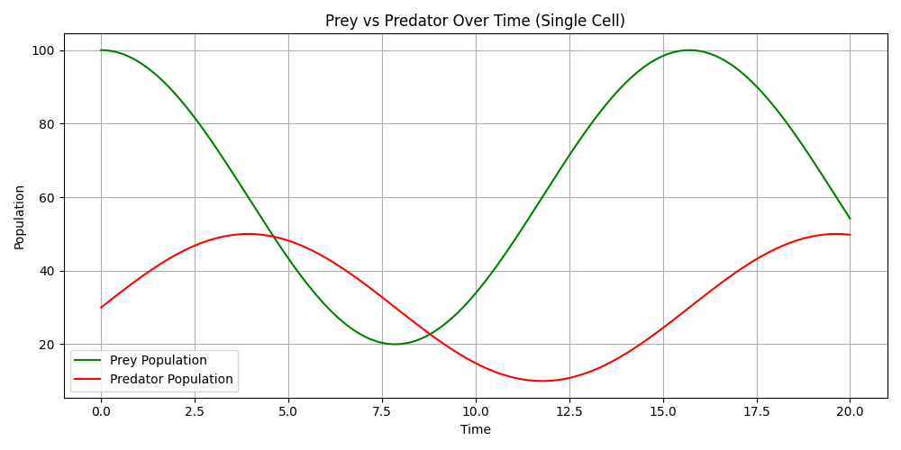
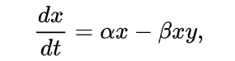
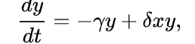
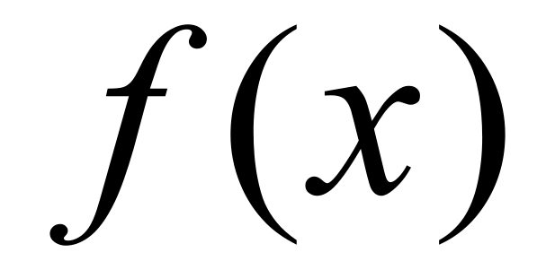

ALGORITHIM
Prey population change:
Predator population change:
6
Slide 6
Search Presentation

Slide 9

1. Validate rates (alpha, beta, gamma, delta > 0)
2. Compute grid size from total population
3. Initialize grid with rabbits & wolves per cell
4. Store initial data, validate to frontend
5. Create process pool (use all CPU cores)
6. For each year:
- Build args list from grid
- Parallel map with pool → updated grid
- Sum total rabbits & wolves
- Emit updates & performance if socketio
7. Close pool, return results & stats
Pseudo Code

Slide 10
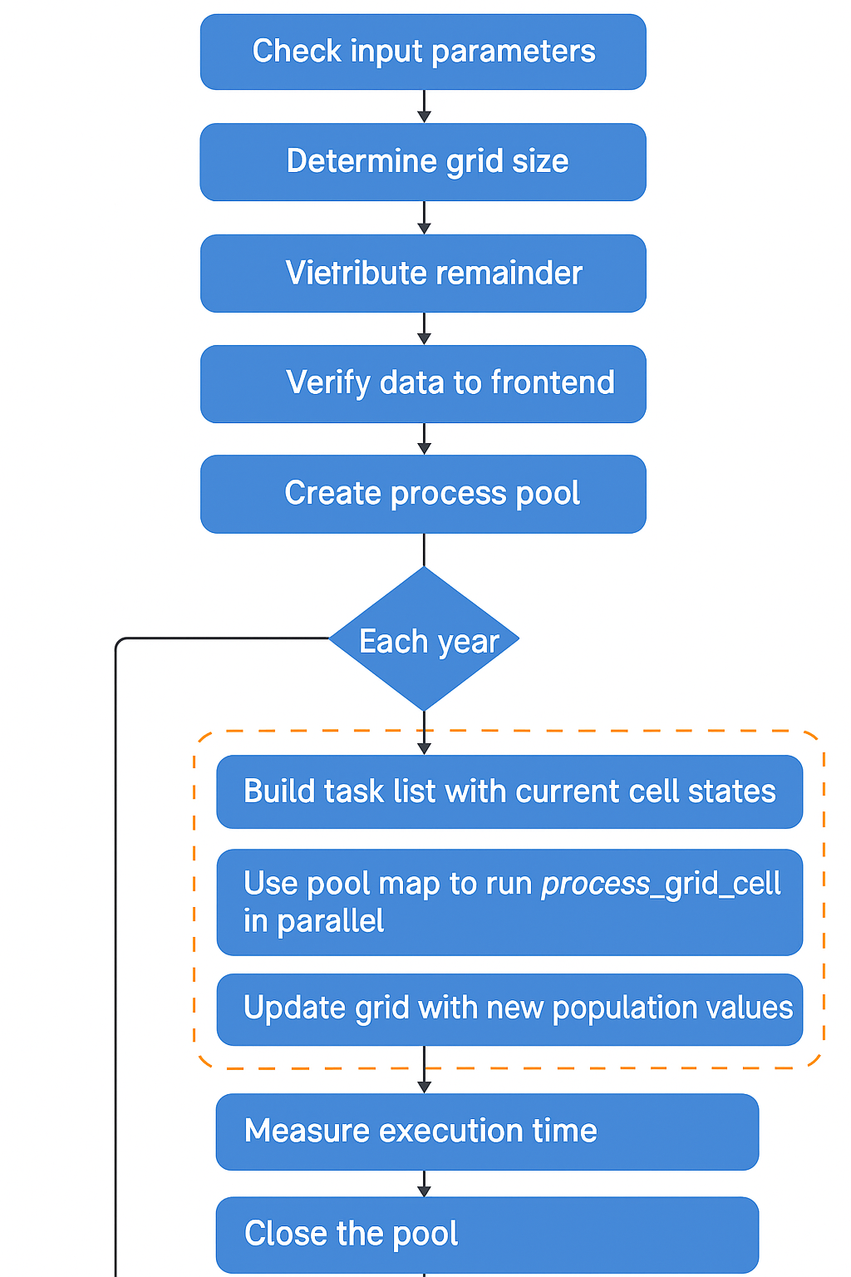
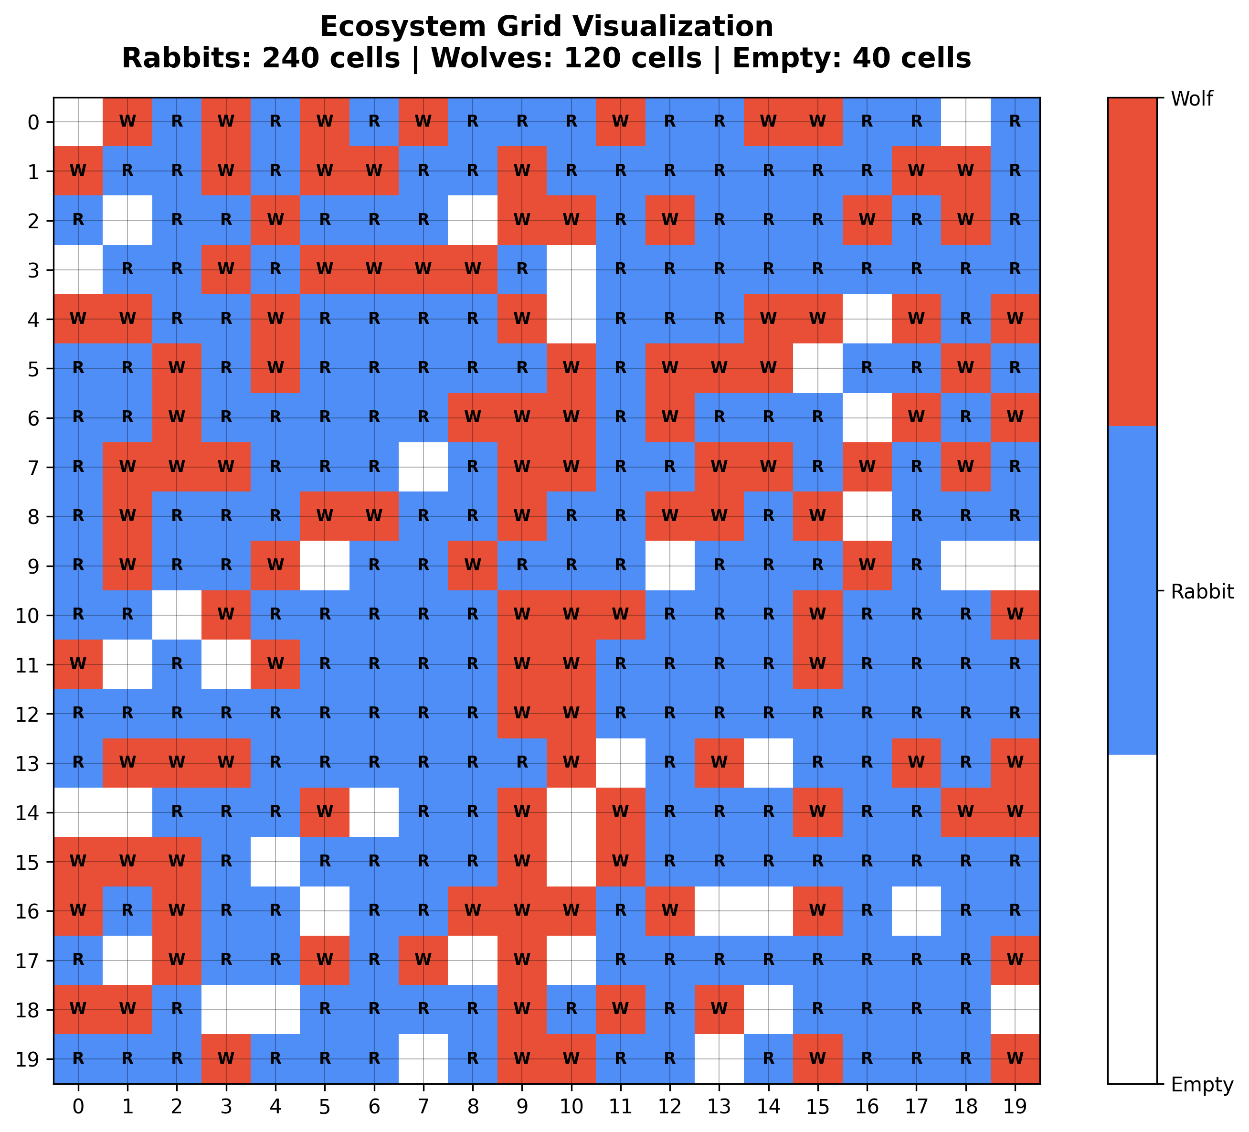

Visualization

Slide 11








TOOLS AND TECHNOLOGY
FRONTEND TOOLS
BACKEND TOOLS
9
Slide 9
next slide

Slide 12

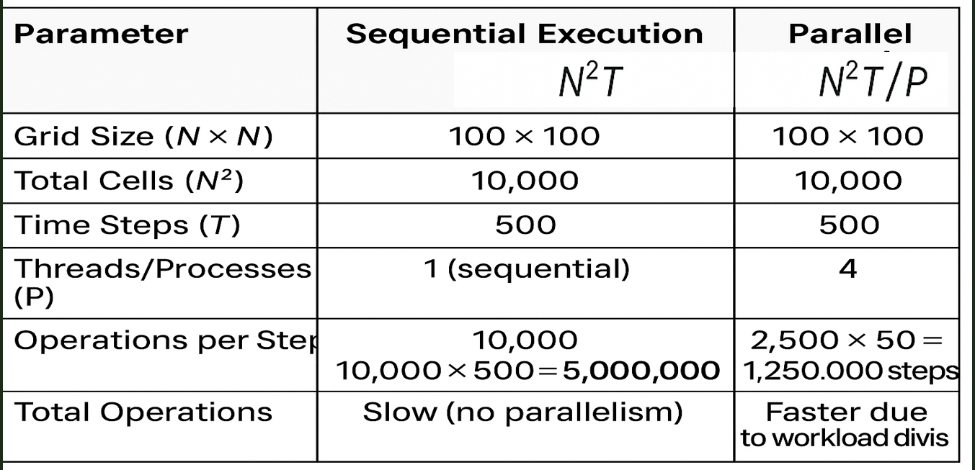

COMPLEXITY ANALYSIS
SERIAL VS PARALLEL TIME COMPLEXITY
10
Slide 10
NEXT SLIDE

Slide 13
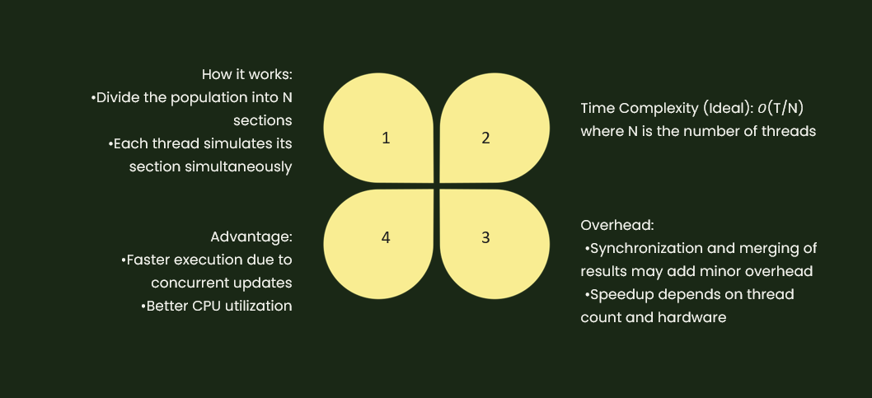

Slide 14


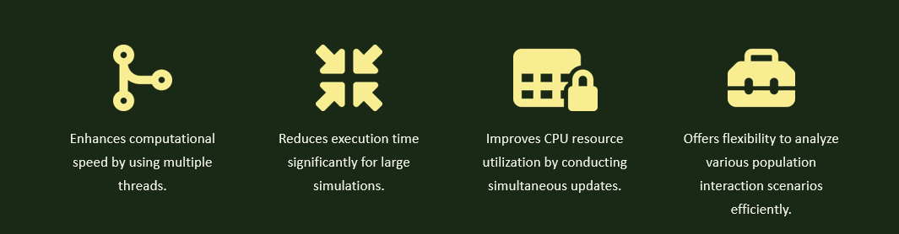
CONCLUSION
12
NEXT SLIDE
Slide 12

Slide 15
Thank You
For Your Attention
End of Slide
13
Slide 13
LAST SLIDE

